Slide 1
KNN Algorithms
data_pt_rem_jan21

Slide 2


IRONHACK BOOTCAMP
K Nearest Neighbors
To make a decision, KNN will look
at the K nearest points!

Slide 3
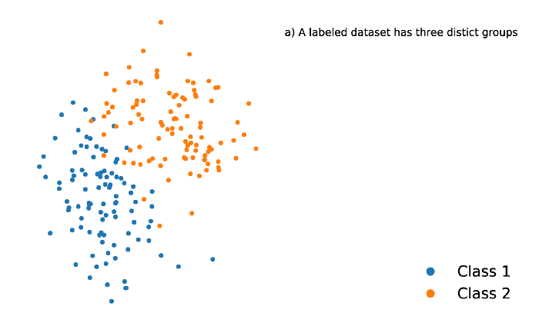
IRONHACK BOOTCAMP
KNN Classifier
KNN applied to a
classification problem

Slide 4
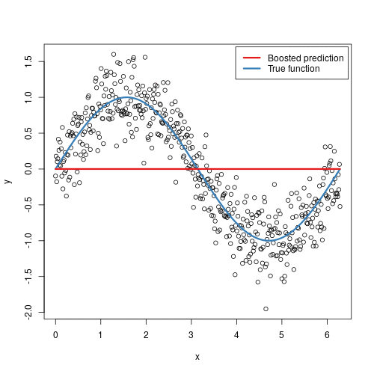
IRONHACK BOOTCAMP
KNN Regressor
KNN applied to a
regression problem

Slide 5
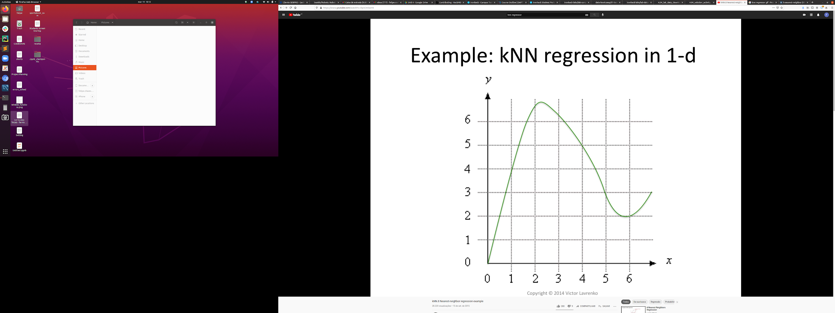
IRONHACK BOOTCAMP

Slide 6

IRONHACK BOOTCAMP

Slide 7
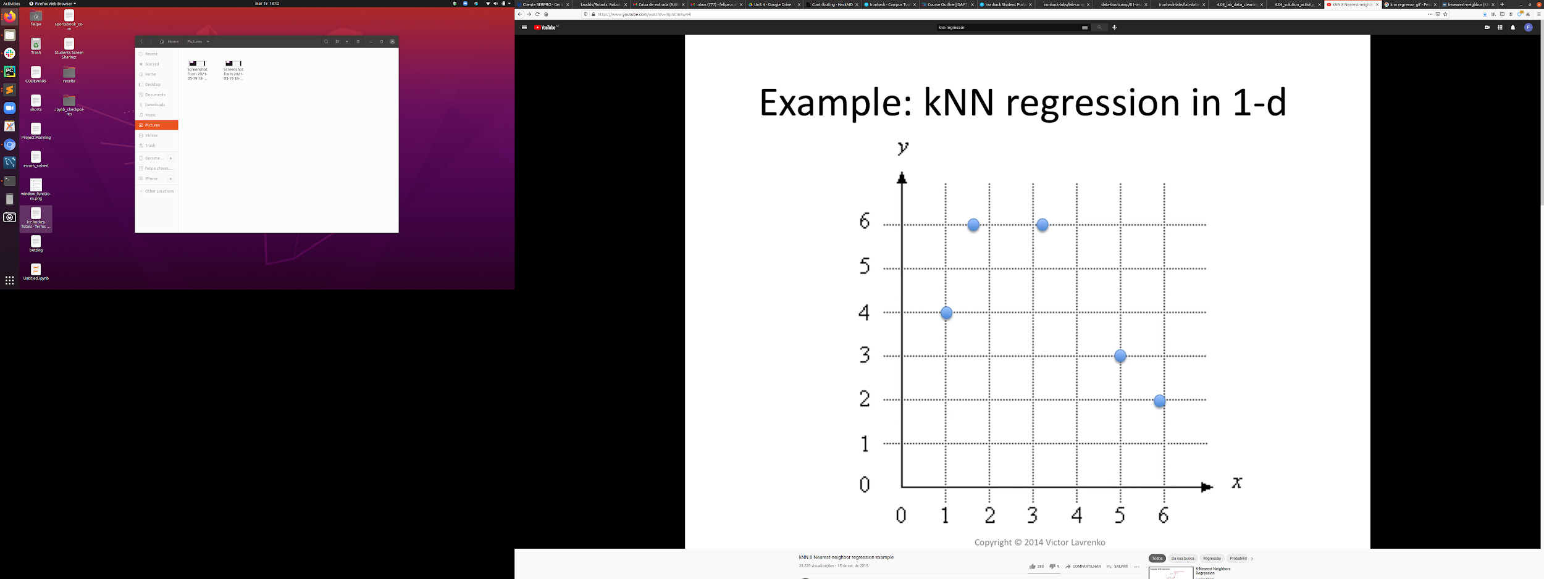
IRONHACK BOOTCAMP

Slide 8

IRONHACK BOOTCAMP

Slide 9

IRONHACK BOOTCAMP

Slide 10
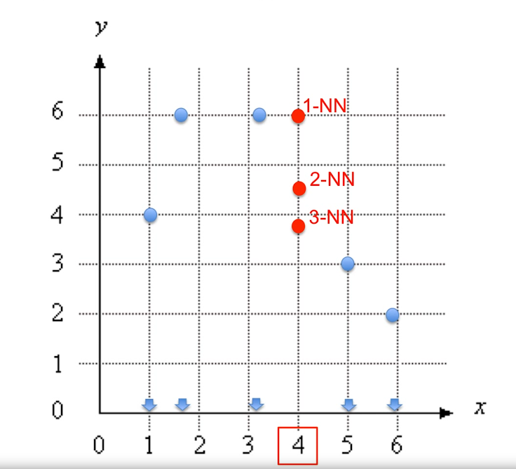
IRONHACK BOOTCAMP

Slide 11
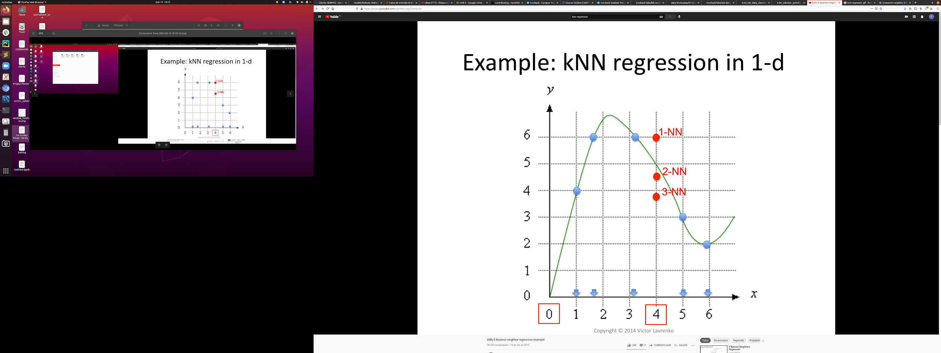
IRONHACK BOOTCAMP
https://www.youtube.com/watch?v=3lp5CmSwrHI

Slide 12


